Slide 1

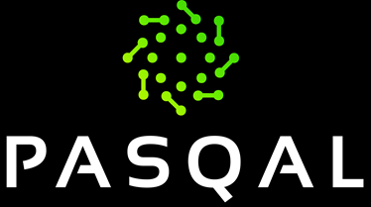
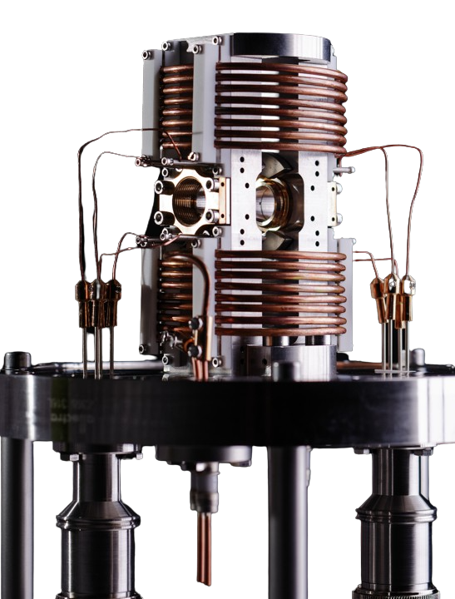
QUANTUM PROCESSING UNITS WITH NEUTRAL-ATOMS:
APPLICATIONS AND EMULATION
Emulation Team
Engineering Department

Slide 2
OUTLINE
THE NEUTRAL ATOMS QUANTUM PROCESSOR
APPLICATIONS
EMULATION OF THE QPU
MEASUREMENT AND CONTROL
PERSPECTIVE

Slide 3
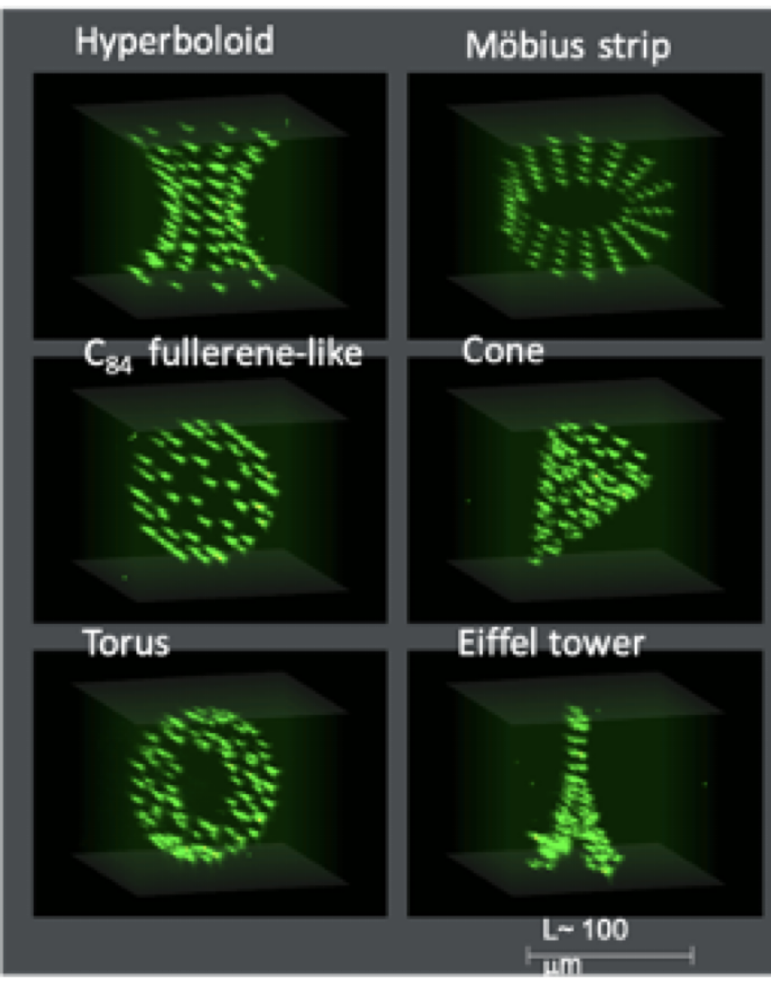
the neutral atoms quantum processor
Our qubits are Neutral Atoms trapped in very stable arrays of optical tweezers.
Long-range interactions appear between Rydberg atoms, with inherent high connectivity.
Quantum information is stored in the electronic state of the atoms.
Scalable technology: Up to hundreds of qubits, in arbitrary geometries
Notes:
Tensor Core: Programmable Matrix Multipliy and accumulate

Slide 4
the neutral atoms quantum processor
When a neutral atom e.g. Rubidium is excited to a very high principal quantum number level :
Very reactive to electric and magnetic fields, long decay periods
Outermost electron, very far from the nucleus, feels an almost hydrogenic potential.
Called Rydberg Atom.
Notes:
Tensor Core: Programmable Matrix Multipliy and accumulate

Slide 5
the neutral atoms quantum processor
Rydberg atoms can be trapped using an optical tweezer.
For example, one can prepare several Rubidium atoms in the same targeted “ground state” (e.g. 5p)
Then one can act with additional lasers that drive transitions from the ground state to an excited Rydberg state.
Notes:
Tensor Core: Programmable Matrix Multipliy and accumulate

Slide 6











the neutral atoms quantum processor
By driving transitions between selected levels, a qubit can be defined, whose state is determined by the laser parameters.
The qubit state becomes
a function of laser parameters
With precise laser control, one can build arbitrary one-qubit gates.
Notes:
Tensor Core: Programmable Matrix Multipliy and accumulate

Slide 7

the neutral atoms quantum processor
Two excited atoms interact with a Van der Waals term that decays quickly with the interatomic distance.
Notes:
Tensor Core: Programmable Matrix Multipliy and accumulate

Slide 8
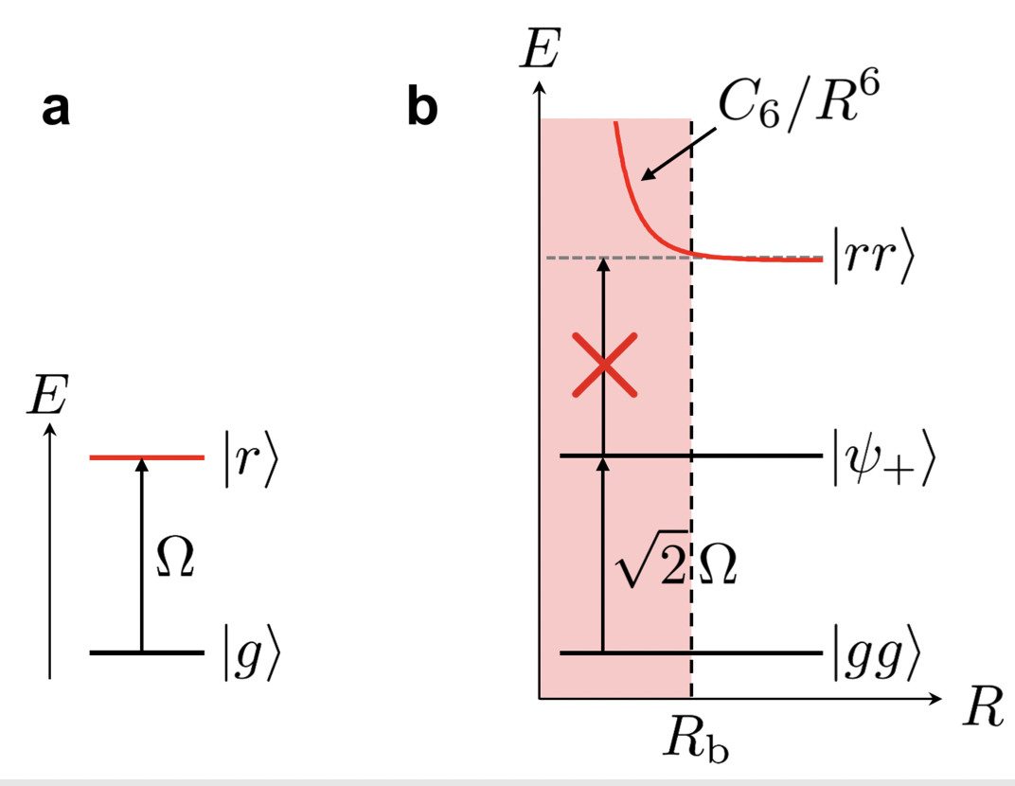




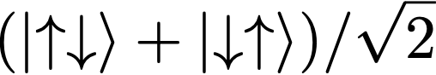





the neutral atoms quantum processor
When two atoms are close enough, a strong interaction appears. As a two-body operator, using :
A doubly excited state is suppressed by the interaction energy cost. This is called the “Blockade Effect”. Instead, an entangled state is observed.
An effective “Blockade Radius” can be defined from this phenomenon.
Browaeys, A., & Lahaye, T. (2020). Many-body physics with individually controlled Rydberg atoms. Nature Physics, 16(2), 132-142.
Notes:
Tensor Core: Programmable Matrix Multipliy and accumulate

Slide 9


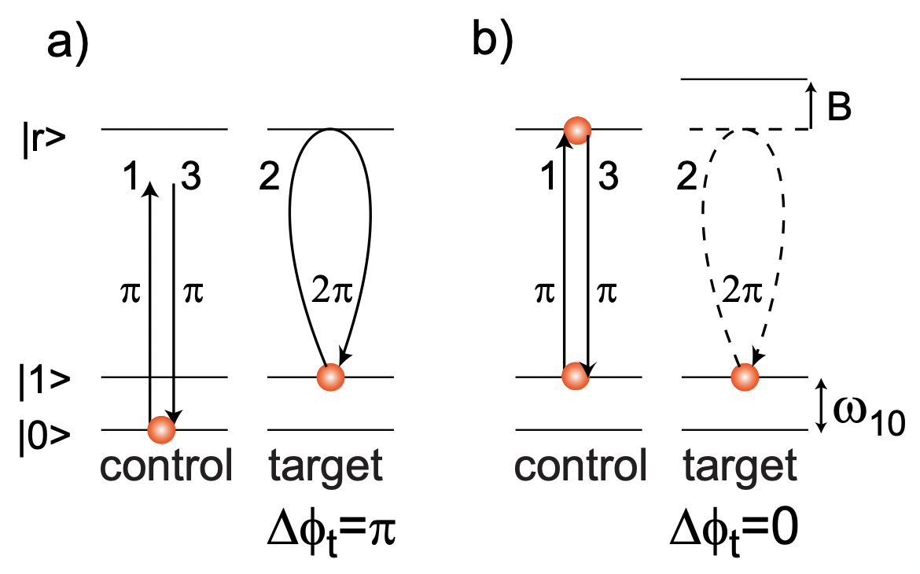
the neutral atoms quantum processor
The blockade effect is the basis to construct multi-qubit gates. In a common setup, two hyperfine ground states are chosen as logical states and while a rydberg level is used as an auxiliary state.
Saffman, M., Walker, T. G., & Mølmer, K. (2010). Quantum information with Rydberg atoms. Reviews of modern physics, 82(3), 2313.
By including Hadarmard gate on the target qubit before and after this sequence, one obtains a CNOT gate.
Together with one-qubit gates, this constitutes a universal set of gates for quantum computing
Notes:
Tensor Core: Programmable Matrix Multipliy and accumulate

Slide 10

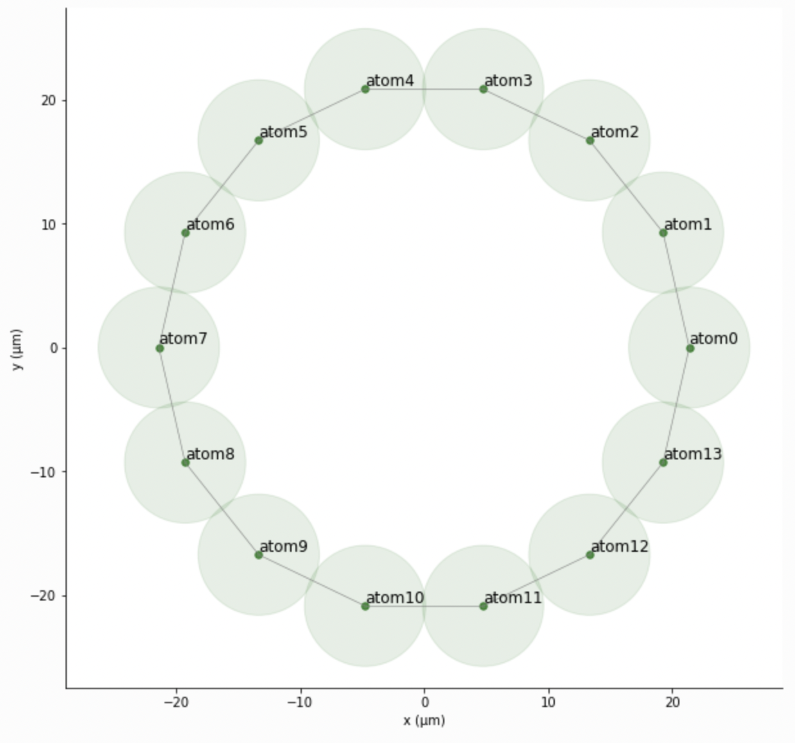



the neutral atoms quantum processor
In the analog mode. The system evolves under an effective Ising-like Hamiltonian with for example a single control in the Rabi Frequency of the Laser:
Notice the Graph defined by the (rydberg-blocked) atoms in the register is highly customizable, therefore allowing for a custom connectivity!
This type of platform serves as a basis for Quantum Simulation, using the Ising Hamiltonian as a Resource.
Notes:
Tensor Core: Programmable Matrix Multipliy and accumulate

Slide 11
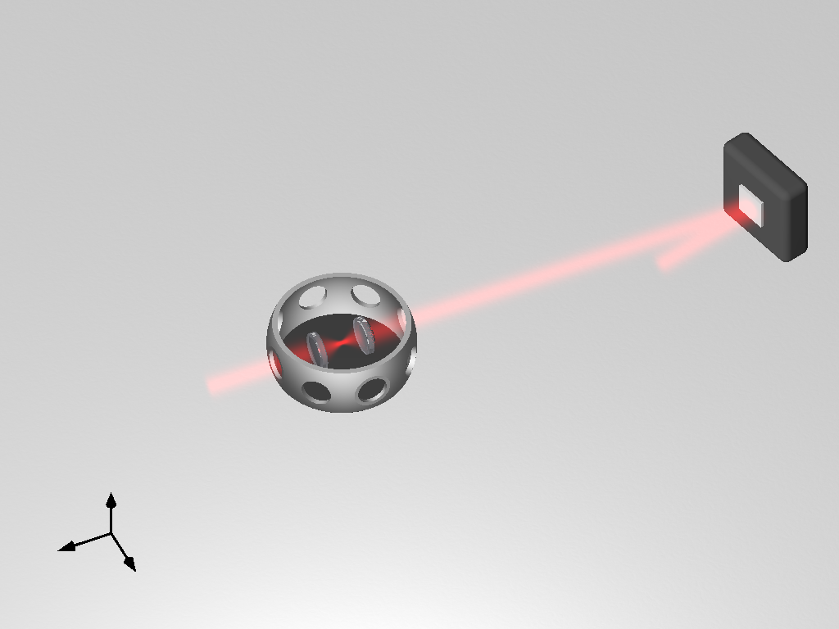
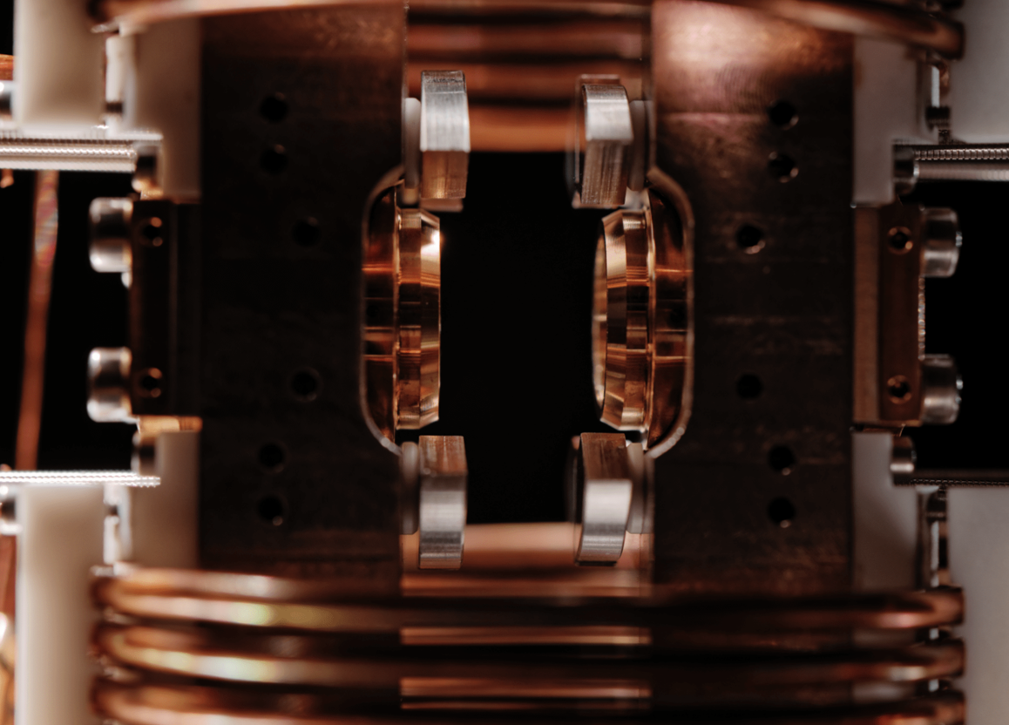
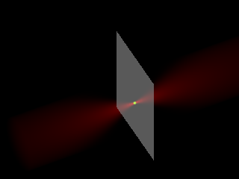
the neutral atoms quantum processor
SLM (Spatial Light Modulator) modulates the intensity/phase of the beam.
The interplay of the optical tweezer system and the SLM allows for the loading (up to several hundred!) atoms.
SLM
Vacuum System
Henriet, L., Beguin, L., Signoles, A., Lahaye, T., Browaeys, A., Reymond, G. O., & Jurczak, C. (2020). Quantum computing with neutral atoms. Quantum, 4, 327.
Notes:
Tensor Core: Programmable Matrix Multipliy and accumulate

Slide 12
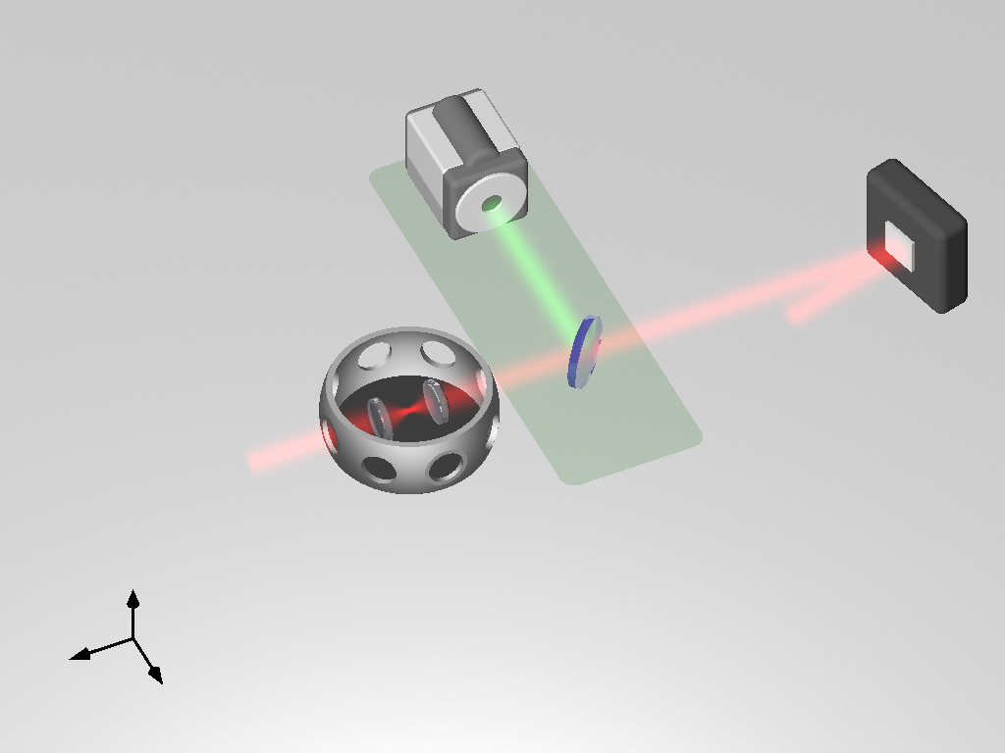
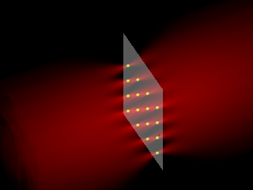
the neutral atoms quantum processor
CCD Camera
SLM
A CCD camera captures photons emitted from trapped atoms (via fluorescence)
The observed pixels define “zeros” of a projective measurement of the state
Vacuum System
Henriet, L., Beguin, L., Signoles, A., Lahaye, T., Browaeys, A., Reymond, G. O., & Jurczak, C. (2020). Quantum computing with neutral atoms. Quantum, 4, 327.
Notes:
Tensor Core: Programmable Matrix Multipliy and accumulate

Slide 13
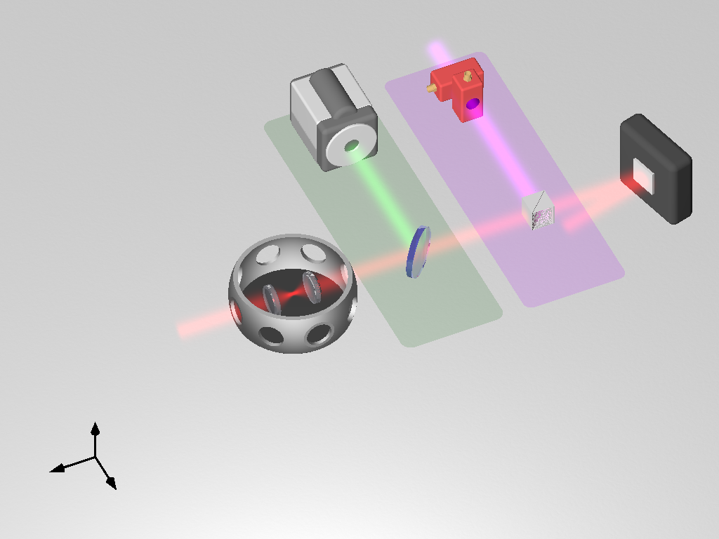
the neutral atoms quantum processor
AOD
Camera
SLM
An AOD (acousto-optic deflector) modifies the laser beam to move individual atoms and obtain the desired array.
Several rearrangement steps are produced, with fluorescence captures between the operations to ensure the atom array is correct.
Vacuum System
Beam Splitter
Henriet, L., Beguin, L., Signoles, A., Lahaye, T., Browaeys, A., Reymond, G. O., & Jurczak, C. (2020). Quantum computing with neutral atoms. Quantum, 4, 327.
Notes:
Tensor Core: Programmable Matrix Multipliy and accumulate

Slide 14
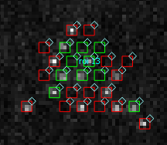
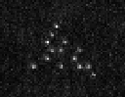
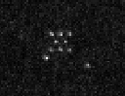
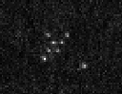
the neutral atoms quantum processor
Trap pattern
Loading optical tweezers
Rearrangement
Pulse sequence
Desired graph (green)
Absence of atom = Rydberg state
Notes:
Tensor Core: Programmable Matrix Multipliy and accumulate

Slide 15
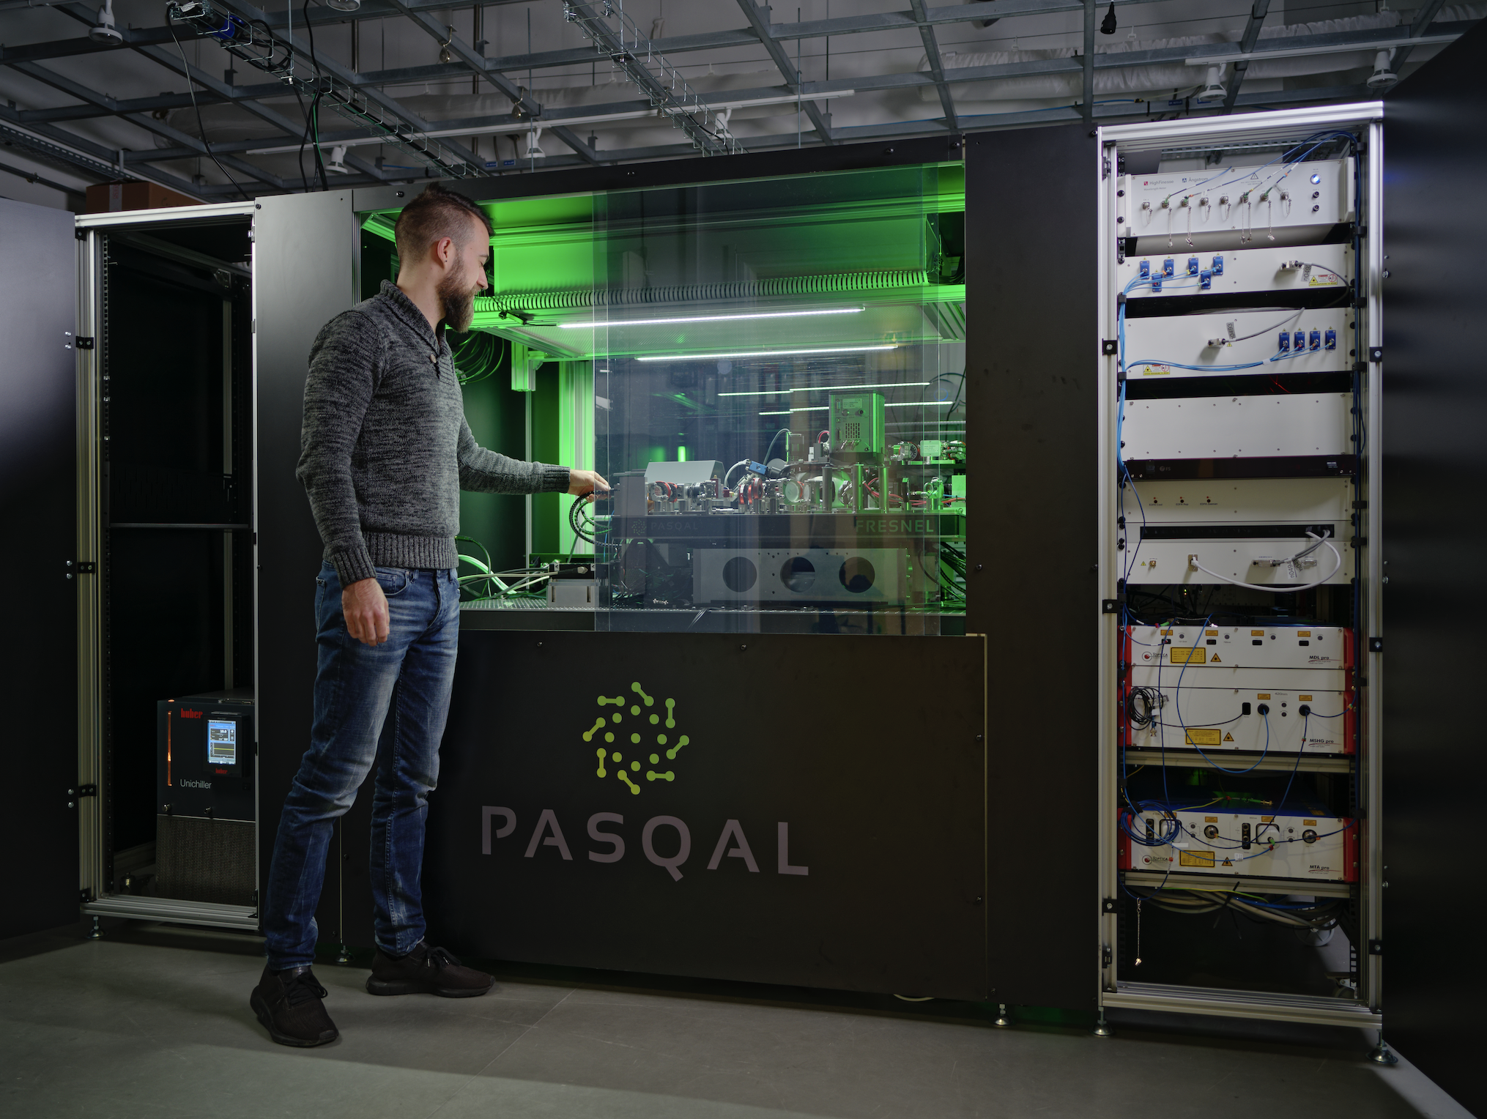
THE NEUTRAL ATOMS QUANTUM PROCESSOR
PASQAL is a spin-out of Institut d’Optique Graduate School (Pailaseau, France), from the Laboratory of Antoine Browaeys and Thierry Lahaye.
Built upon several generations of experience in fundamental research.
We build quantum processors made of neutral atoms.
Notes:
Tensor Core: Programmable Matrix Multipliy and accumulate

Slide 16
EMULATION OF THE QPU
Emulation (not just Simulation) happens at different stages:
Compilation of a Circuit into Pulse Sequences : Hardware-Efficient translation
Compilation of a Program into Machine Operations (simulate all the steps from register creation to readout and a higher level algorithm) : Reproduce Specific Device Characteristics > Device Noise Model
Emulation: Compilation + Noise Model + Classical Simulation of the Quantum System
Notes:
Tensor Core: Programmable Matrix Multipliy and accumulate

Slide 17
EMULATION: using Pulser
Channels
Local
Register
Global
Local
Device
Silvério, H., Grijalva, S., Dalyac, C., Leclerc, L., Karalekas, P. J., Shammah, N., ... & Henriet, L. (2022). Pulser: An open-source package for the design of pulse sequences in programmable neutral-atom arrays. Quantum, 6, 629.
Sequence

Slide 18
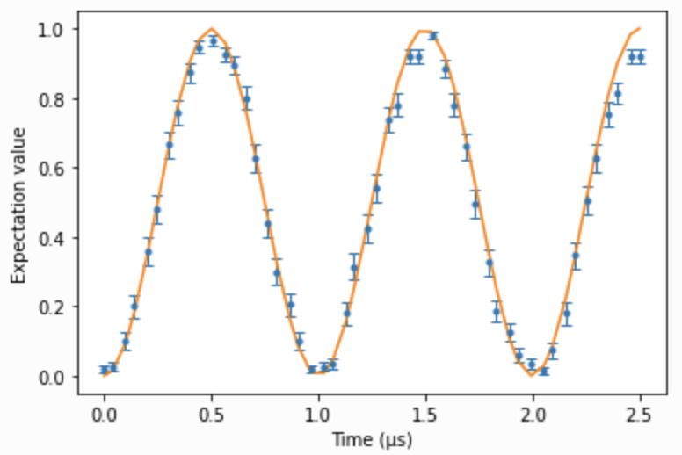
EMULATION: using Pulser
Goal: straightforward time-evolution simulation for all the instructions in the sequence.
Based on the qutip package: includes python-optimized algorithms and data-structures. Direct access to numerical configuration parameters (tolerances, evaluation times, solver methods).
Includes a customizable noise model based on neutral-atom controls: laser amplitude fluctuations, SPAM errors, doppler effect, and effective noise channels (solved with a Quantum Master Equation).
sim = Simulation(my_sequence)
results = sim.run() #Schroedinger equation solver for clean systems
bitstrings = results.sample_final_state(300)
cfg = SimConfig(noise=('SPAM’),
eta=0.01,
epsilon=0.05,
epsilon_prime=0.02)
my_sim.set_config(cfg)
noisy_results = sim.run()
noisy_results.plot(my_observable)

Slide 19
EMULATION: using Pulser
Full Installation: pip install pulser
Pre-requisites:
Python 3.7 or higher
Recommended: Jupyter Notebook installed
GitHub Repository: https://github.com/pasqal-io/Pulser
Documentation: https://pulser.readthedocs.io/

Slide 20
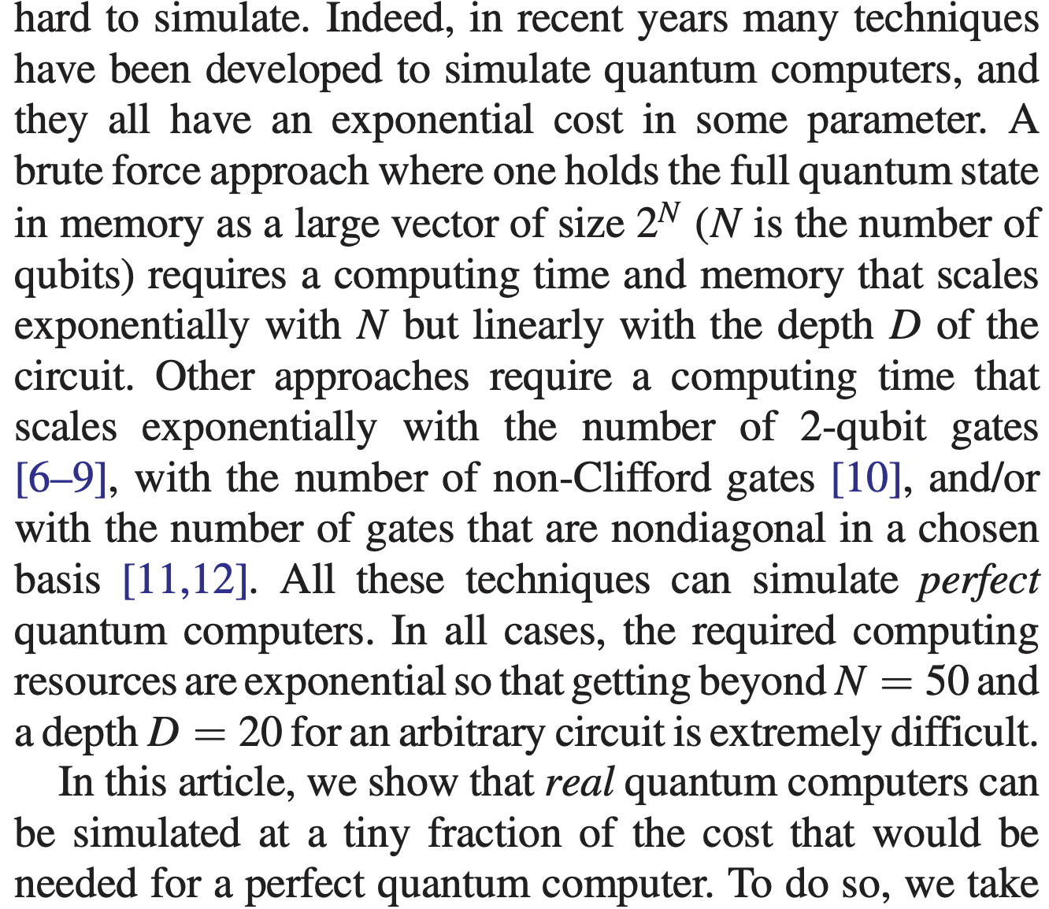
EMULATION OF THE QPU
What limits the simulation of quantum computers?
State Vector Evolution (Schrodinger Equation)
Density Matrix (Quantum Master Equation)
Tensor Network Simulations.
Zhou, Y., Stoudenmire, E. M., & Waintal, X. (2020). What limits the simulation of quantum computers?. Physical Review X, 10(4), 041038.
Notes:
Tensor Core: Programmable Matrix Multipliy and accumulate

Slide 21
HIGH PERFORMANCE EMULATORS
We have two main projects in emulation, written in Julia:
Examples of simulation tasks:
2µs dynamics for a 10x10 square array of atoms interacting with Ising coupling and using the resulting MPS to calculate entanglement entropy (using EMU-T).
Multi-threaded simulation of a set of parametrized noisy pulse sequences for a 20-qubit system to determine an optimal shape (using EMU-S)
EMU-T | EMU-S
Based on Tensor Networks (iTensors.jl) Simulates dynamics with TDVP algorithm. Can handle several tasks in 1D and 2D atom geometry, based on MPS. (In Development) PEPS dynamics. | Based on State Vector evolution Uses Krylov methods as well as Julia’s DifferentialEquations.jl package Includes Noise model from Pulser Includes Parallelization algorithms for stochastic Schrödinger equation jobs.

Slide 22
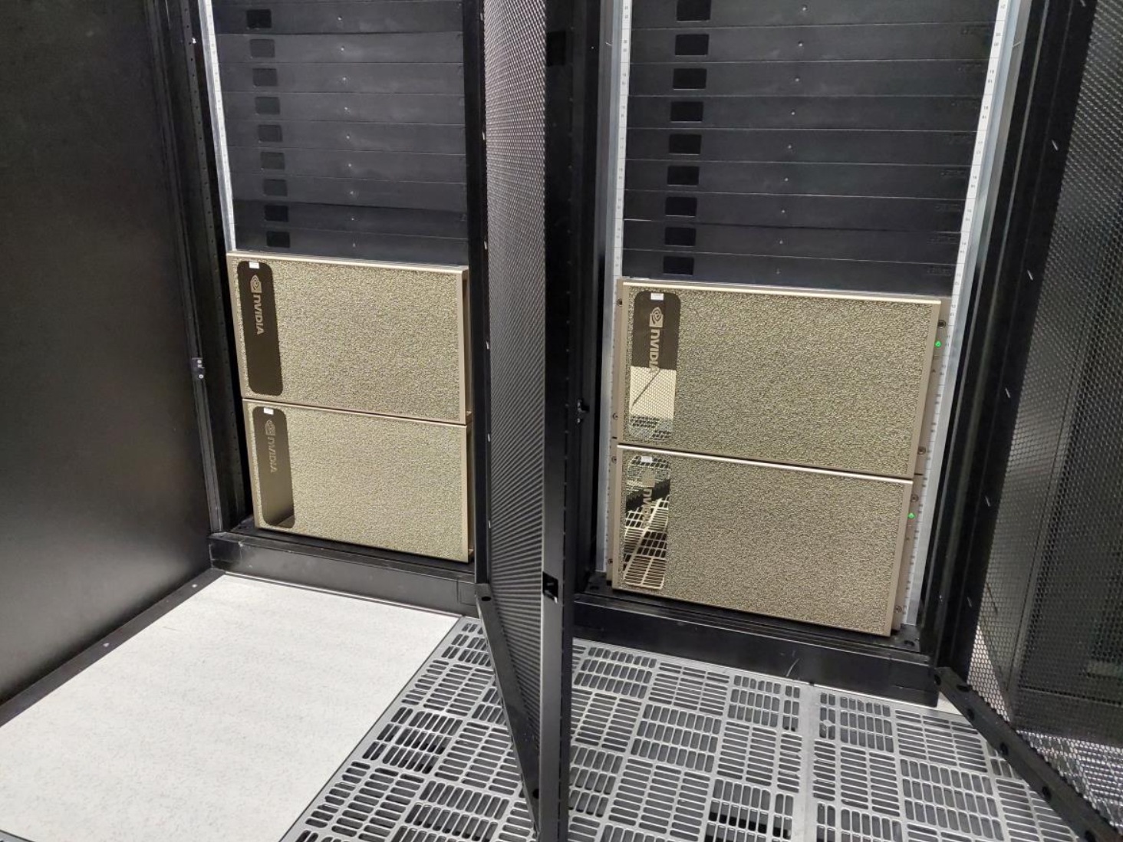
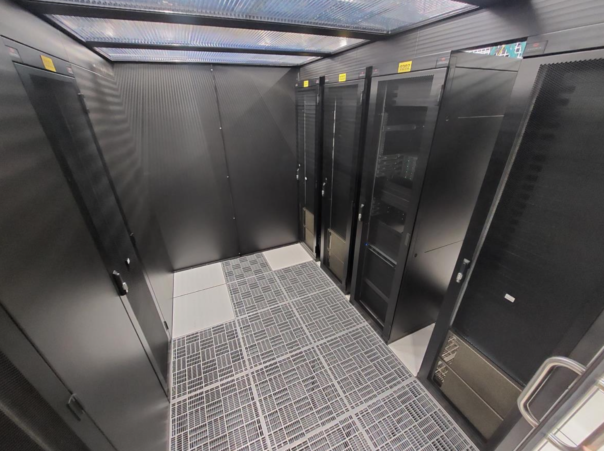
PASQAL dgx GPU cluster
HARDWARE SPECIFICATIONS:
Cluster of 10 nodes with DGX A100 320 GB, 2x AMD Rome 7742 (64 cores/ 2,25 GHz) processors, and 1 TB RAM
Mellanox® Quantum(TM) HDR InfiniBand Switch

Slide 23
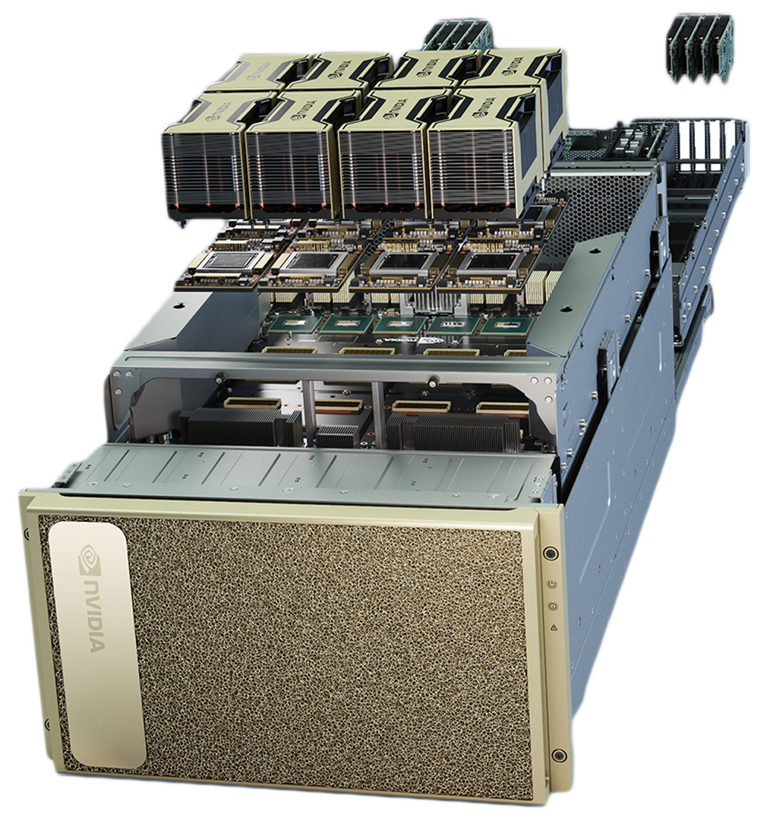
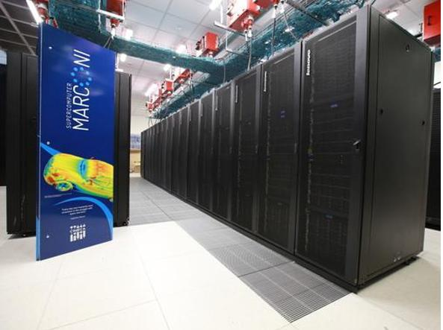
OVERVIEW
Applications SDK (QUBO, UD-MIS, QEK, DQC)
Quantum Computing Framework (Pulser, PasQasm)
Quantum Circuit Emulators (pulser-simulation, EMU-T, EMU-R)
PASQAL QPU
PASQAL GPU Cluster
HPC Centers

